Slide 1
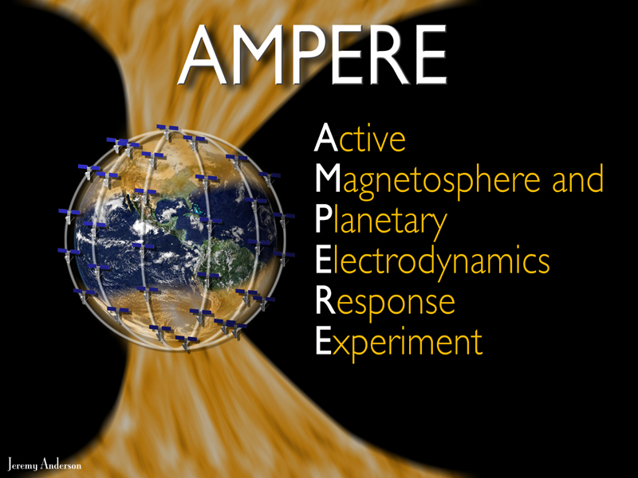
Active
Magnetosphere and Planetary Electrodynamics Response
Experiment
Status and Highlights
B. J Anderson, L. P. Dyrud, H. Korth , R. J. Barnes, and V. G. Merkin
The Johns Hopkins University Applied Physics Laboratory

Slide 2
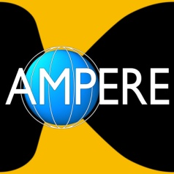
Outline
Capsule summary
Development and data collection status
Products
Applications with SuperDARN: Lasse et al., Merkin et al. (this meeting)
… and a little nitty gritty, i.e. reality

Slide 3
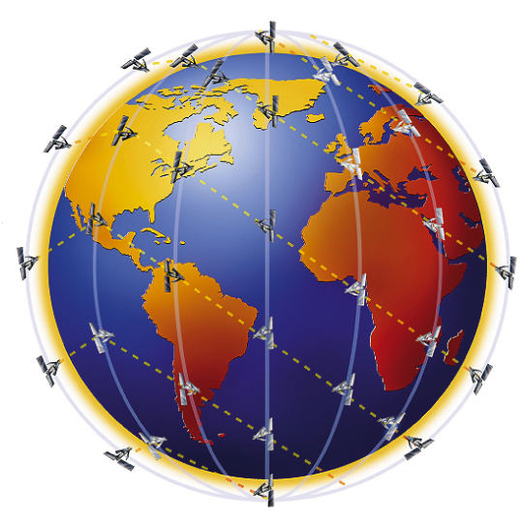
Iridium for Science
Magnetometer on every satellite
  Part of avionics
  30 nT resolution: S/N ~ 10
>70 satellites, 6 orbit planes, ~11 satellites/plane
Six orbit planes provide 12 cuts in local time
9 minute spacing: re-sampling cadence
780 km altitude, circular, polar orbits
Polar orbits guarantee coverage of auroral zone
Global currents never expand equatorward of system

Slide 4
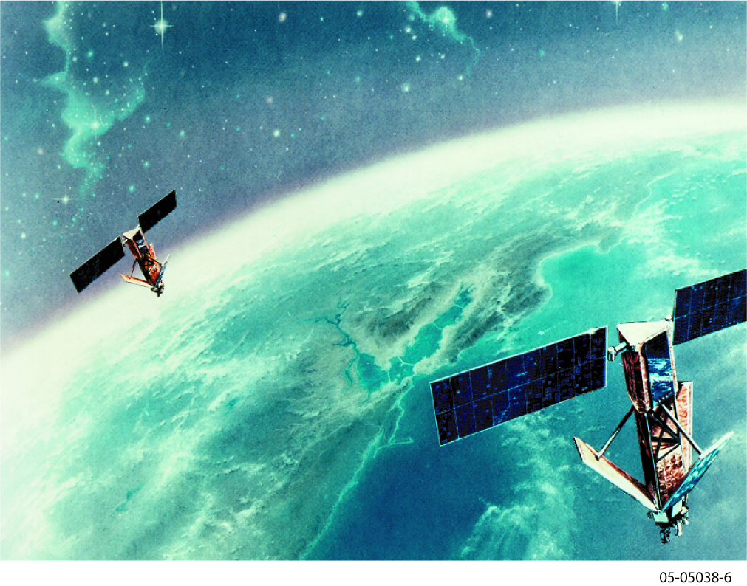
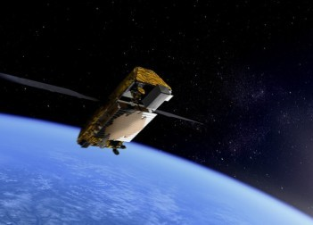
Iridium Communications Inc.
New company founded in 2000
Assumed assets of original Iridium
Profitable since 2001
Majority of revenue non DoD
Estimated satellite constellation life: 2014+
Iridium NEXT funded and going forward: launches 2015-2017
AMPERE continuation is in the plans for NEXT

Slide 5
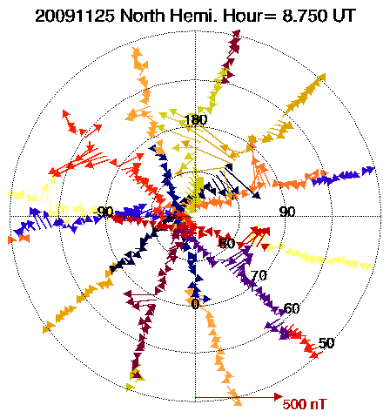
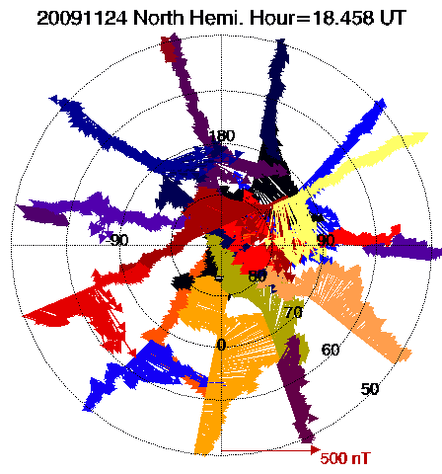
Data Acquisition Implemented
Side-by-side comparison of data acquired in 10 minutes Old: ~200 s/sample
Standard AMPERE: complete coverage with ~1° lat. res. 19.4 s/sample
High rate AMPERE: ~ 0.1° lat. res. 2.16 s/sample
Old Data
AMPERE: Standard
AMPERE: High
10/01/2002 11:55-12:05
11/25/2009 08:45-08:55
11/24/2009 18:27-18:37
TLM data from all satellites
Different colors denote different satellites

Slide 6
AMPERE System Overview
Flight software acquires magnetometer samples at 20s or 2s intervals on every satellite 24/7
Transmits to ground in real-time over satellite network
Store & dump data used fill any gaps; definitive orbit/attitude
Flight Software
Ground Architecture
Real-time stream
Supplementary
Product Generation
TLM files
Real-time Extractor
& Processor
Database
Data
Accounting
TLM files
Store-dump Extractor
& Processor
Store & dump
Data Transmission
Constellation
JHU/APL
AMPERE Science
Notes:
This is AMPERE ☺ Basically it just requires upgrades to the current Iridium system – need a flight software and a ground system upgrade
With AMPERE we will get continuous, global observations of large scale FAC system – in real time, with 9 minute cadence
WHY THIS IS NOT DIRT CHEAP: A FLIGHT SOFTWARE UPLOAD TO AN OPERATIONAL, PROFITABLE SATELLITE CONSTELLATION PROVIDING ON-DEMAND SERVICE TO COMMERCIAL AND MILITARY CUSTOMERS WORLD WIDE.

Slide 7
Technical Status: A
Space segment
  Space software development, test, upload and commissioning completed: 31 May 2010
  Space segment Operations Readiness Review: 24 May 2010
Ground data systems
  Data ingestion and accounting completed (Boeing)
  Transition to new hardware gradual (Boeing)
  Data transfer and receipt in place (secure ftp, 24/7)

Slide 8
Technical Status: B
Science Data Center
  Data ingestion: beta version complete
    Pre-processing: archive, merge, model field comparison/evaluation, attitude analysis
    Repair: ‘bad actor’; residuals weighting, gaps
  Inversions: fit to δB; derivation of J_{f}
    Full sphere fit beta version completed (IDL version)
    High resolution cap fits in final development
    Convert all to compiled code for execution speed
  Coordinate system transformations and derivation of data products
  Data access system
    Patterned on SuperDARN system
    Browse and basic displays: beta version completed

Slide 9
Magnetic Field Pre-processing
Read initial hourly files
Spline and filter SC attitude
Rotate IGRF into SC coordinates
Cross calibrate against IGRF: scale factorsLinear regression ΔB_{j} = a_{j}+Σc_{i}*B_{i}
Subtract IGRF and Patch model
Fill in data gaps
Filter: T< 120 minutes
Produce Daily files for Final processing
Produce initial survey plots
Step we didn’t expect. Only evident in AMPERE data
Since we are only interested in ΔB, the accuracy of IGRF is not critical for this
Requires additional analysis using quiet-day data
Identifying gaps and intelligently ‘splicing’ automatically is not trivial
Eliminating the need for this step is our next big task

Slide 10
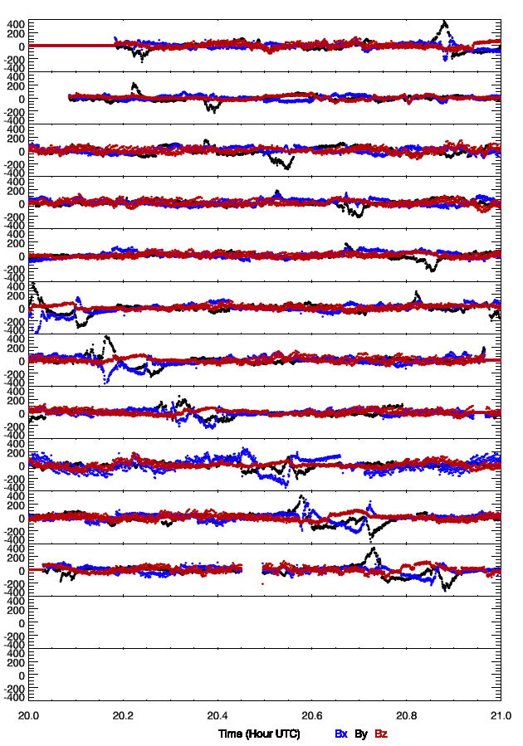
AMPERE
Physical δBs
2009 11/24 2000-2100 UT
All satellites in one plane
δBs consistently observed every nine minutes in subsequent passes.

Slide 11
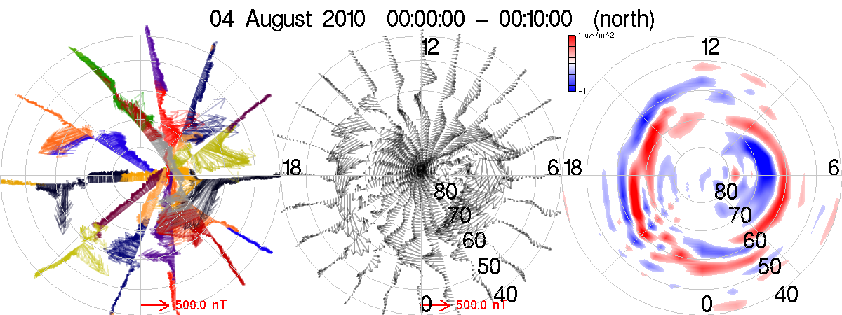
Analysis for ΔB, J_{r}
Vector ∆B, data, continuous ∆B map via SH fit
J_{r} from Ampere’s law applied to horizontal ∆B
Time cadence: 9 min set by inter-spacecraft separation
Lat res: 1.15˚ for 19.44s sampling, 0.13˚ for 2.16s sampling
ΔB
Spherical harmonic fit: ΔB
J_{r} = curl ΔB
Upward J||
Downward J||

Slide 12
Test Data Acquisition Summary
First light: 17 Feb 2009 (brief)
Partial constellation tests selected days/periods: Mar – Sep 2009
Operational testing:
1 Oct 2009 – 31 May 2010
Temporal coverage: >90%
Sporadic time gaps in data from each SV
Occasional high rate test data
Activity / Development Task | Dates
Third flight test and first high rate test | 14 - 21 Apr 2009
Fourth flight test | 19 May 2009
First full constellation data test | 23 Jun - 8 Jul 2009
Second full constellation test, first high rate tests | 29 Sep - 30 Nov 2009
Formal AMPERE space systems operations test | 1 Dec 2009 - 31 May 2010
AMPERE data collection | 1 Jun 2010 - present

Slide 13
High Rate Acquisition Summary
Standard sampling interval: 19.44 s
High rate interval: 2.16 s
Budget for high rate data: 512 h per year (21d 8h)
High rate operation decisions:
Testing (pre June 2010)
Promote on warning: capture storms
Scheduled campaigns: RENU rocket, THEMIS tail season
High rate AMPERE data intervals
Start (UT) | Stop (UT) | Objective
2010 Apr 15 | 2010 Apr 29 | High rate teset
2010 May 27:1100 | 2010 May 29:0300 | Promotion process test
2010 Aug 03:1200 | 2010 Aug 05:0400 | CME
2010 Oct 22:1200 | 2010 Oct 25:0400 | CME
2010 Nov 13:1800 | 2010 Nov 15:1000 | CME
2010 Dec 07-12:0400 | 2010 Dec 07-12:1000 | RENU sounding rocket
2011 Feb 16:0600 | 2011 Feb 18:2200 | CME
2011 Mar 9:0800 | 2011 Mar 11:0000 | CME
2011 May 15: 0900-1300 | 2011 June 30: 0900-1300 | THEMIS

Slide 14
Beta Release: 11 Dec 2010! http://ampere.jhuapl.edu
Inversion results
  Digital data products
  Regular AACGM grid: 1° x 1°
  ΔB fits & J_{r}
Survey displays
  3-panel, ΔB, ΔB fits, J_{r}
  Individual frames and daily movies
  Equator limit: 60° and 40°
Data products browser
Comments suggestions tool
Digital δB data in the works

Slide 15
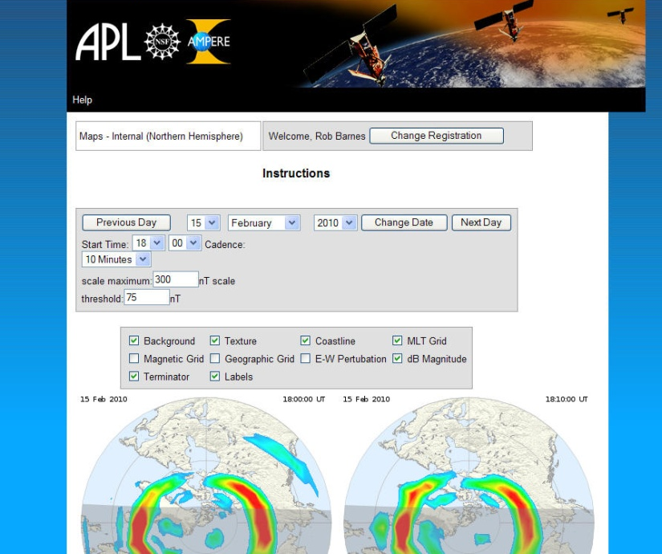
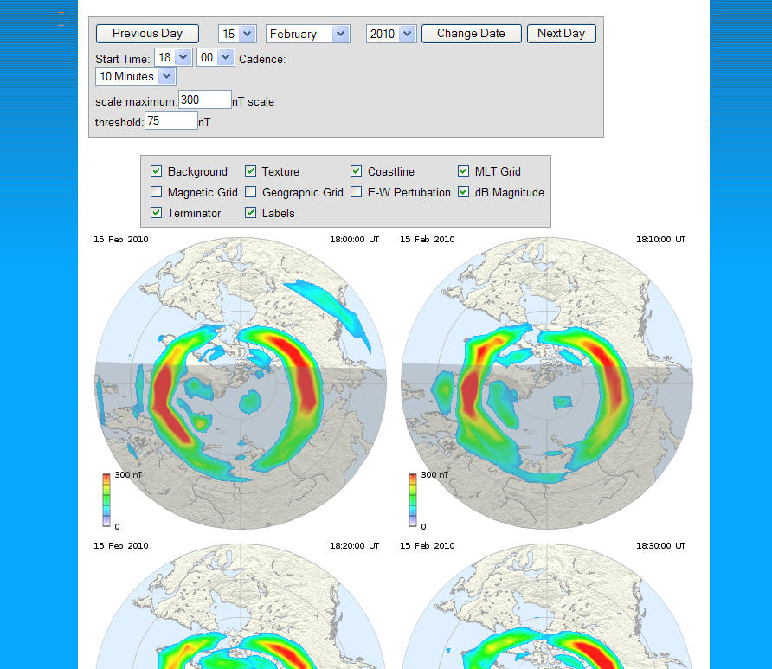
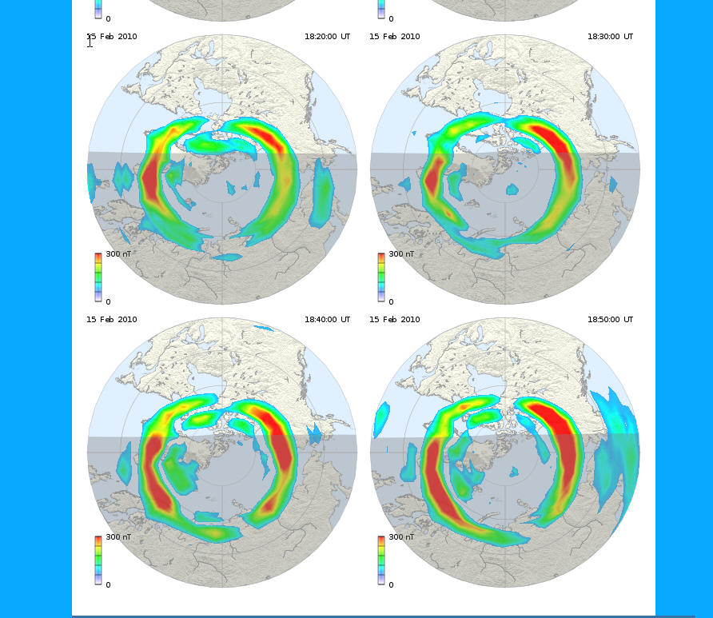
AMPERE Data Center http://ampere.jhuapl.edu
AMPERE Science Data Center data center browser: powered by RST
Accesses auto-processed data: As soon as we process data it shows up for the browser.
Products available for display:
  ∆B magnitude
  ∆B E-W component
  Radial current density: J_{r}
  On 1° x 1° lat-lon in AACGM

Slide 16
Development Timeline
Flight TLM testing began Spring 2009
(Test data: 10/’09-5/’10)
Start 24/7 data collection June 2010
Testing and validation CY 2010
First data release Q4 2010
Real-time development CY 2011
‘Burst’ promotion CY 2012
Development completion May 2013
http://ampere.jhuapl.edu

Slide 17
The Ionospheric electrodynamics view
Convection
SuperDARN
Horizontal currents
= equivalent current potential
Birkeland currents
AMPERE
Electrodynamics equations: 2 eqs, 5 unknowns

Slide 18
Quantity | Technique | Strengths | Operational Considerations
Ψ Equivalent currents | Ground magnetometers | Excellent time resolution; continuous data; coverage improving in latitude, density and southern hemisphere | Non-uniform coverage (oceans, concentration at nominal auroral latitudes, local time gaps)
ϕ Potential convection | SuperDARN: mid-latitudes | Broad field of regard; continuous operation; both hemispheres; 2-min cadence; 10s km resolution | Requires irregularities; D-region absorption (mitigated somewhat by mid-latitude radars)
 | IS radars | Indep. of conditions | Focussed (limited) coverage (few sites)
 | LEO ion drift | Direct ion drift observations | 100 minute revisit time
 |  |  | Restricted local time cuts (4)
Σ_{P}, Σ_{H} | IS radars | Accurate density meas. | Focussed (limited) coverage (few sites)
 | UV imaging | Hemispheric image | Significant uncertainties
 |  |  | Not operational routinely
J|| Birkeland currents | LEO mags | Direct signature of currents | Iridium: long accumulation times (>2 hrs)
 |  |  | Other: ~3 satellites, 100 minute revisit time, Requires geometrical assumptions
 | AMPERE | Direct signature of currents | 30 nT resolution – S:N ~ 10:1
 |  | >70 satellites | Latitude resolution: 1º nominal
 |  | 9 minute revisit time | Event driven sub-degree sampling
 |  | 12 local time cuts

Slide 19
Other applications
E-M Energy Flux
No δB, no S_{z}
|δB| locates regions of S_{z}
Useful for assimilation
Global and ‘uniformly’ distributed
Fundamental physical quantity: δB or j||
Relevant to multiple efforts
Ongoing: AMIE, GAIM
Potential: RCM, MHD

Slide 20
Clausen et al. (SD 2011)
Current latitudes derived from AMPERE
Electromagnetic energy flux
J_{r} from AMPERE compared to vorticity in SD

Slide 21
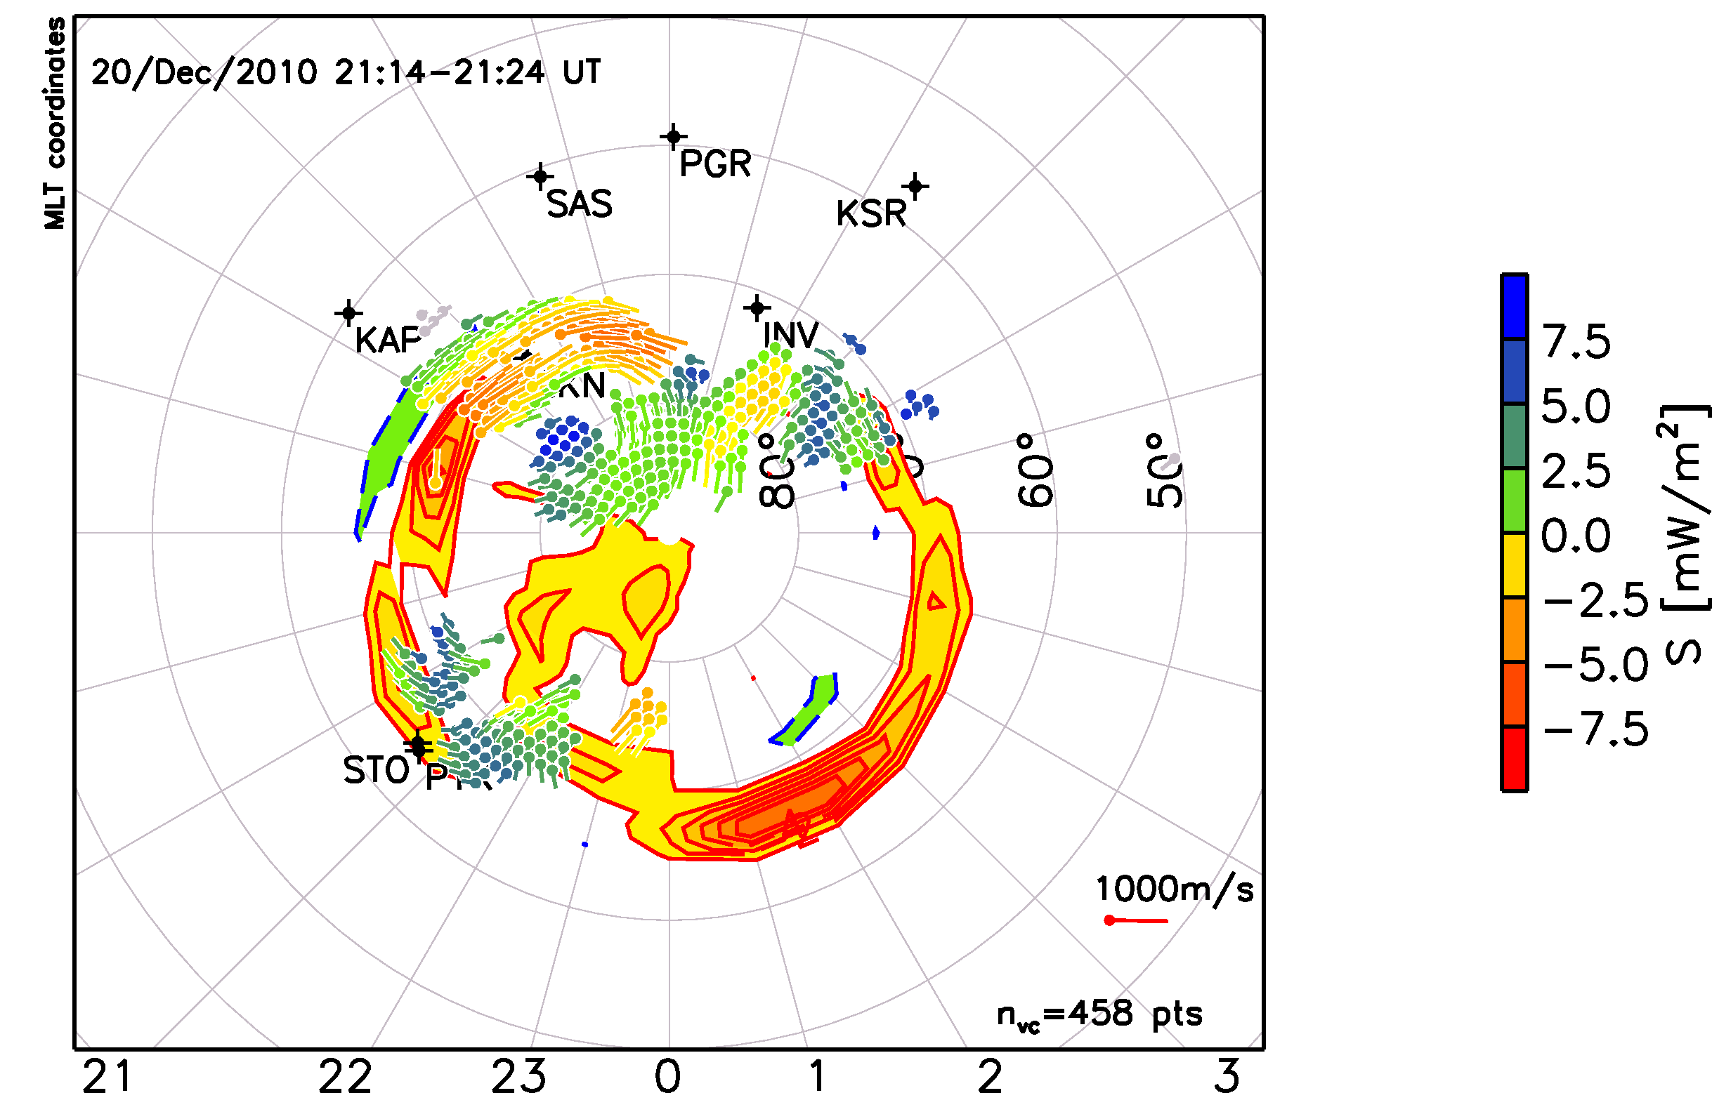
Clausen et al. (SD 2011)
δB from AMPERE with E_{c} from SuperDARN

Slide 22
Convection
SuperDARN
Horizontal currents
= equivalent current potential
Birkeland currents
J|| from AMPERE & Σ_{P}, Σ_{H} from models → derive gradϕ
Electrodynamics equations: 2 eqs, 5 unknowns

Slide 23
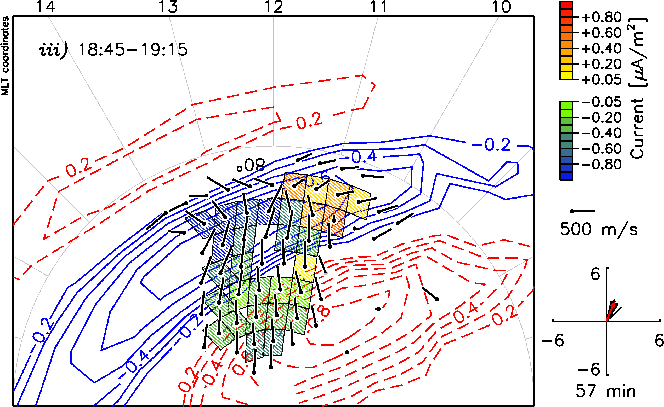
Clausen (SD 2011) 8 Aug 2011
J_{r} estimate from SD using vorticity and model conductance. Overlay on AMPERE J_{r}

Slide 24
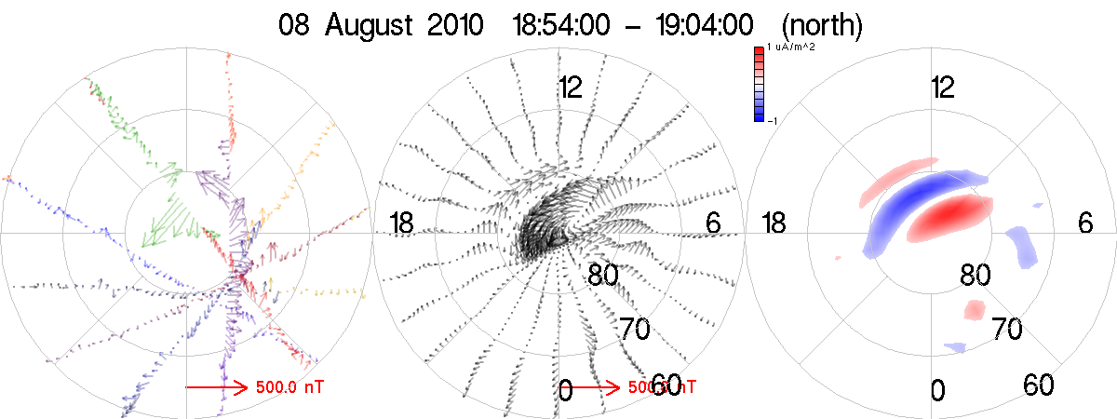
8 Aug 2011

Slide 25
8 Aug 2011

Slide 26
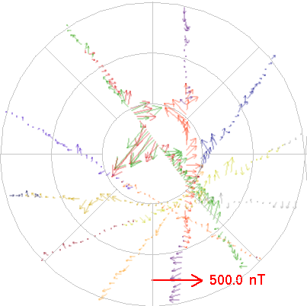
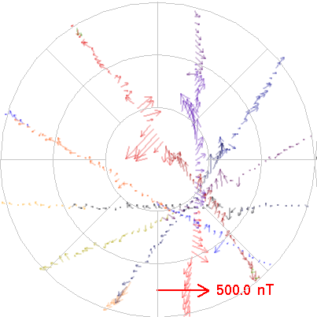
8 Aug 2011
18:44-18:54
18:54-19:04
19:04-19:14

Slide 27
8 Aug 2011

Slide 28
8 Aug 2011

Slide 29
Merkin et al. (SD 2011)
J_{r} from AMPERE
MHD magnetosphere simulation: LFM using ACE solar wind and IMF: provides high altitude temperatures and densities
Ionospheric solver: J_{r} with models for Σ_{P} and Σ_{H}
Investigate sensitivity to different conductances
Independent check of derived locations of flows:
  AMPERE-model derived convection potential
  SuperDARN bi-static flow measurements overlay

Slide 30
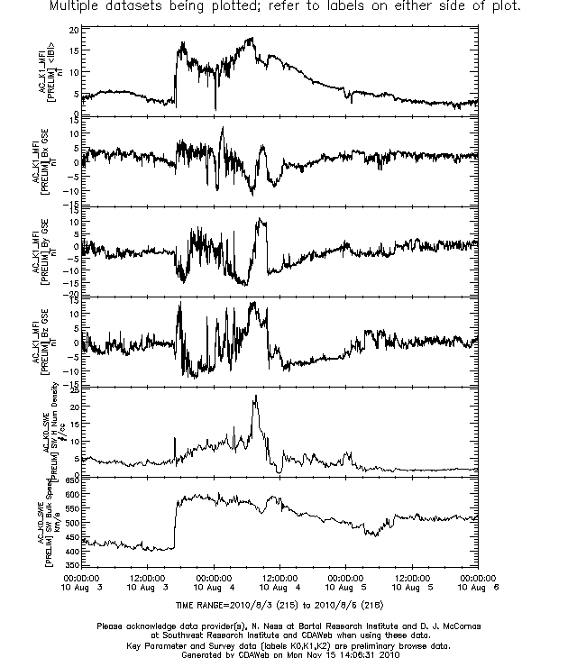
3-5 Aug 2010
Preliminary browse ACE MAG and SWE key parameter data (Ness & McComas)
CME

Slide 31
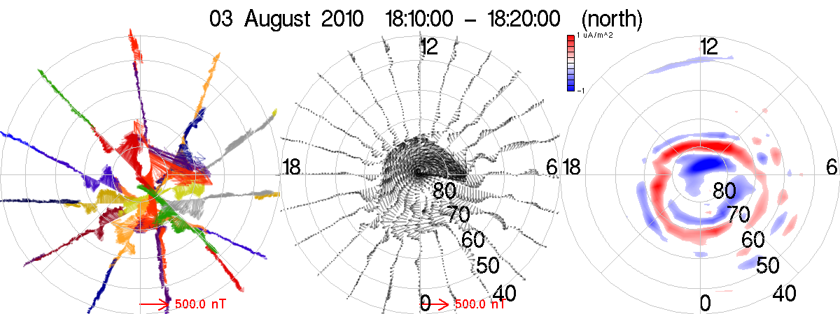
Summary Frame: 1810-1820 UT

Slide 32
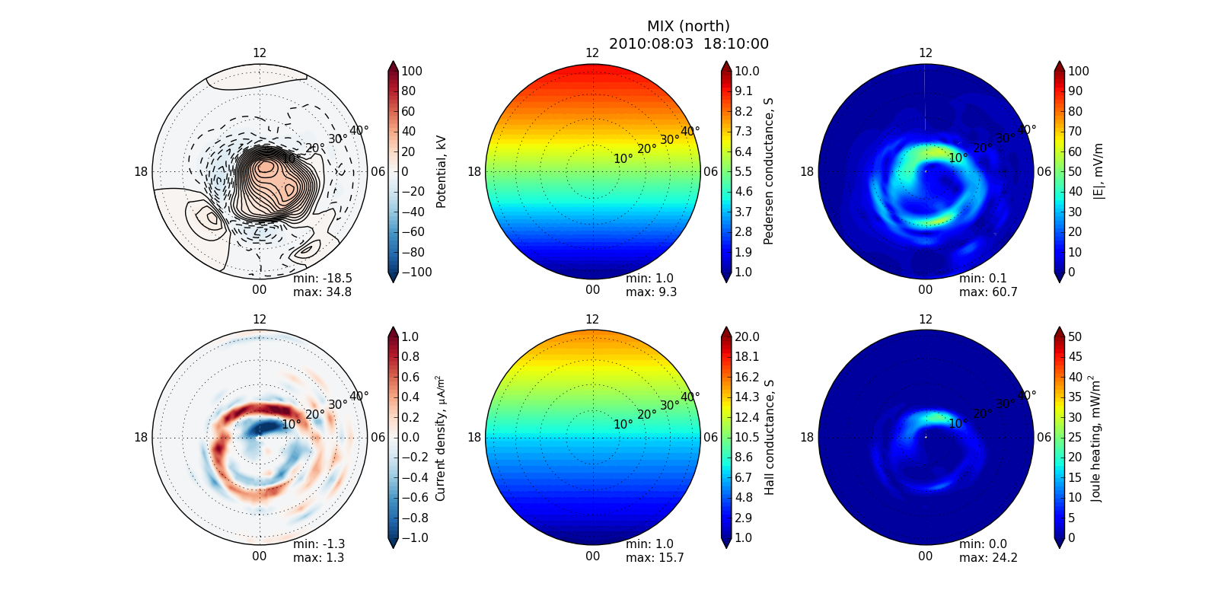
EUV only: 1810-1820 UT

Slide 33
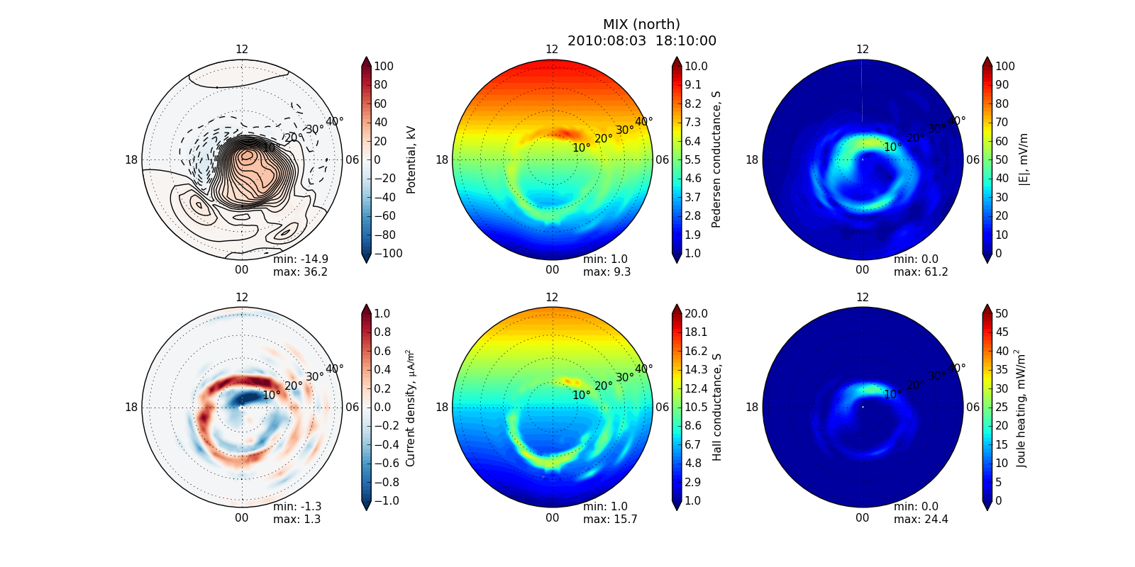
+precip.: 1810-1820 UT

Slide 34

+turbulence: 1810-1820 UT

Slide 35
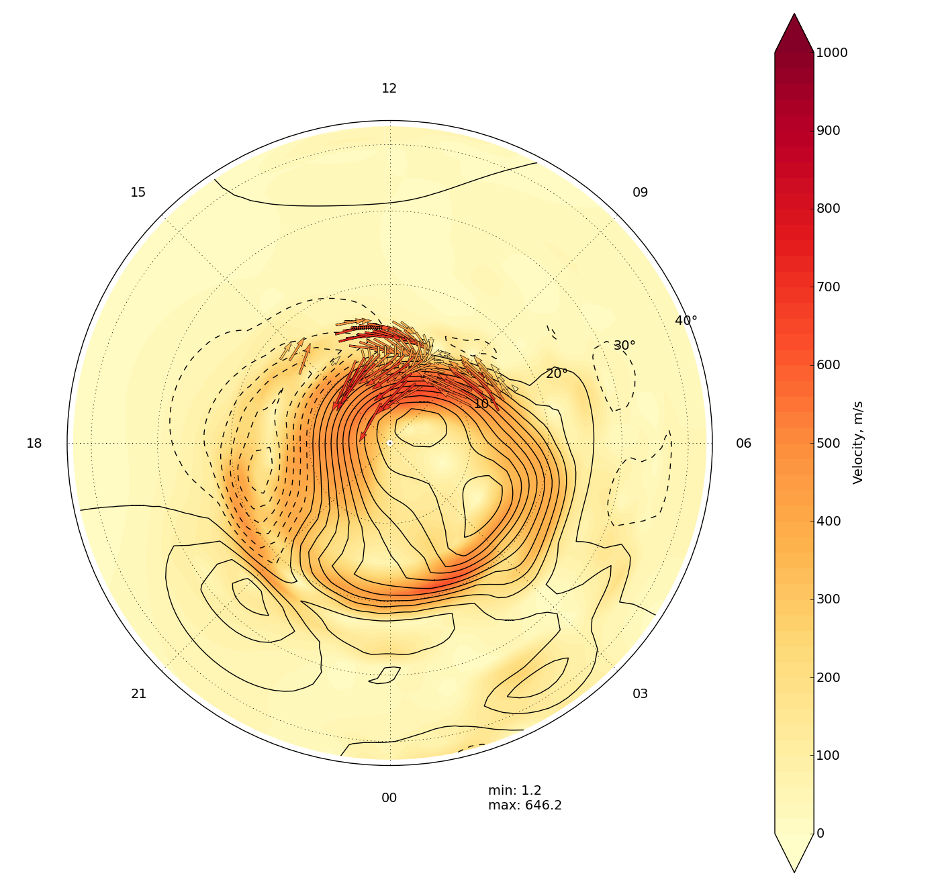
SuperDARN overlay: 1810-1820 UT

Slide 36
Time Development
2010:0803
1904-1922 @ 2 min frames

Slide 37
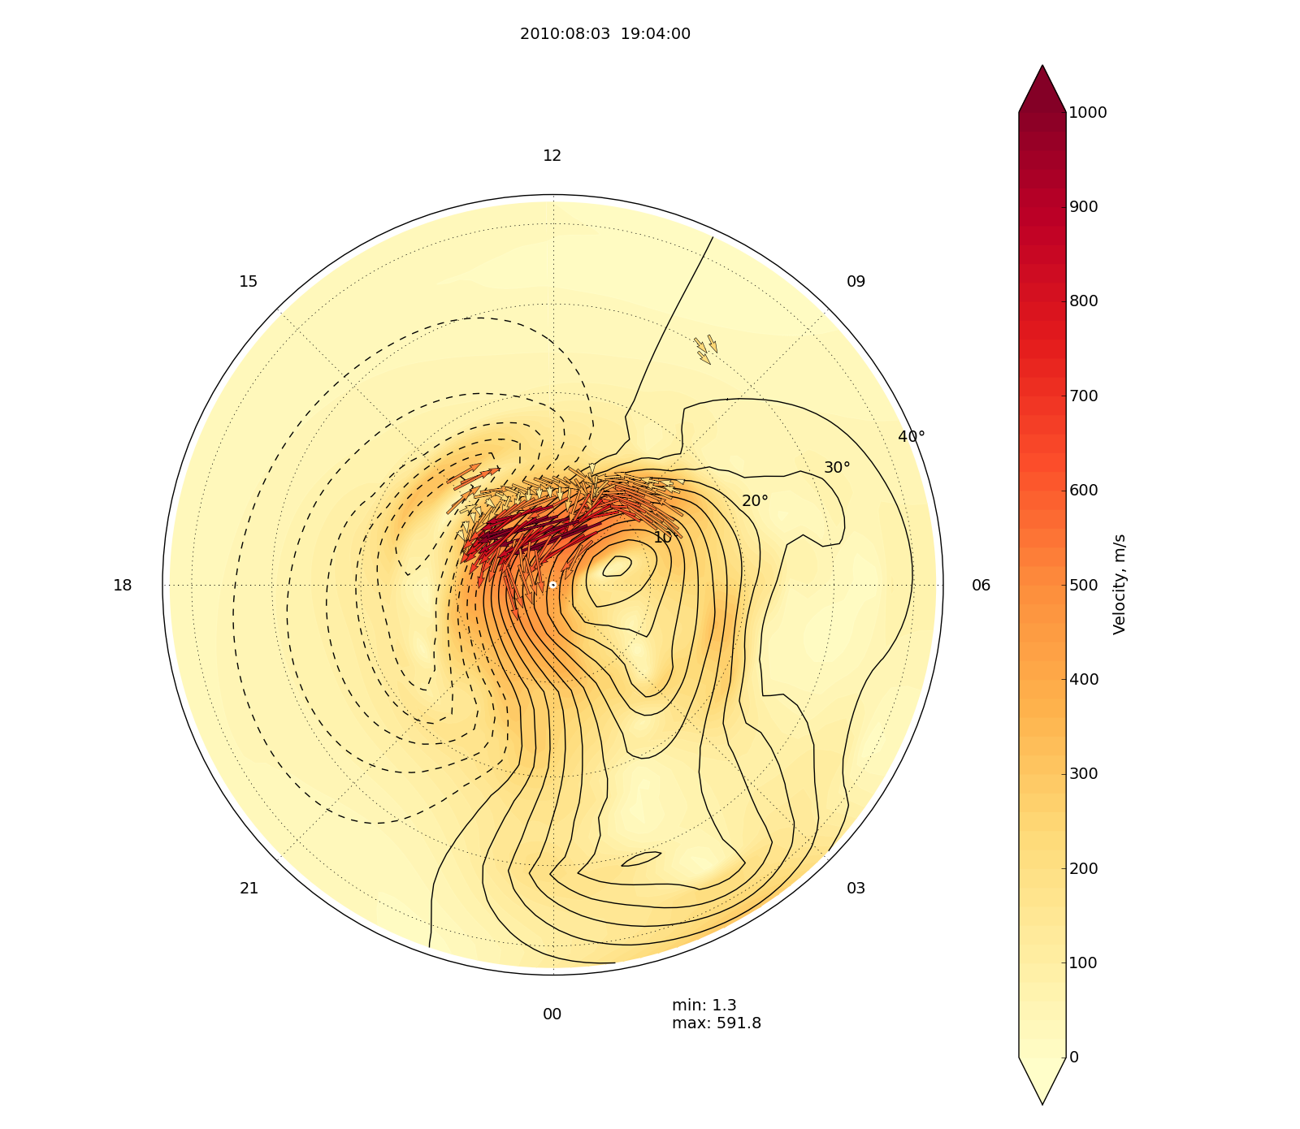
2010:08:03 19:04

Slide 38
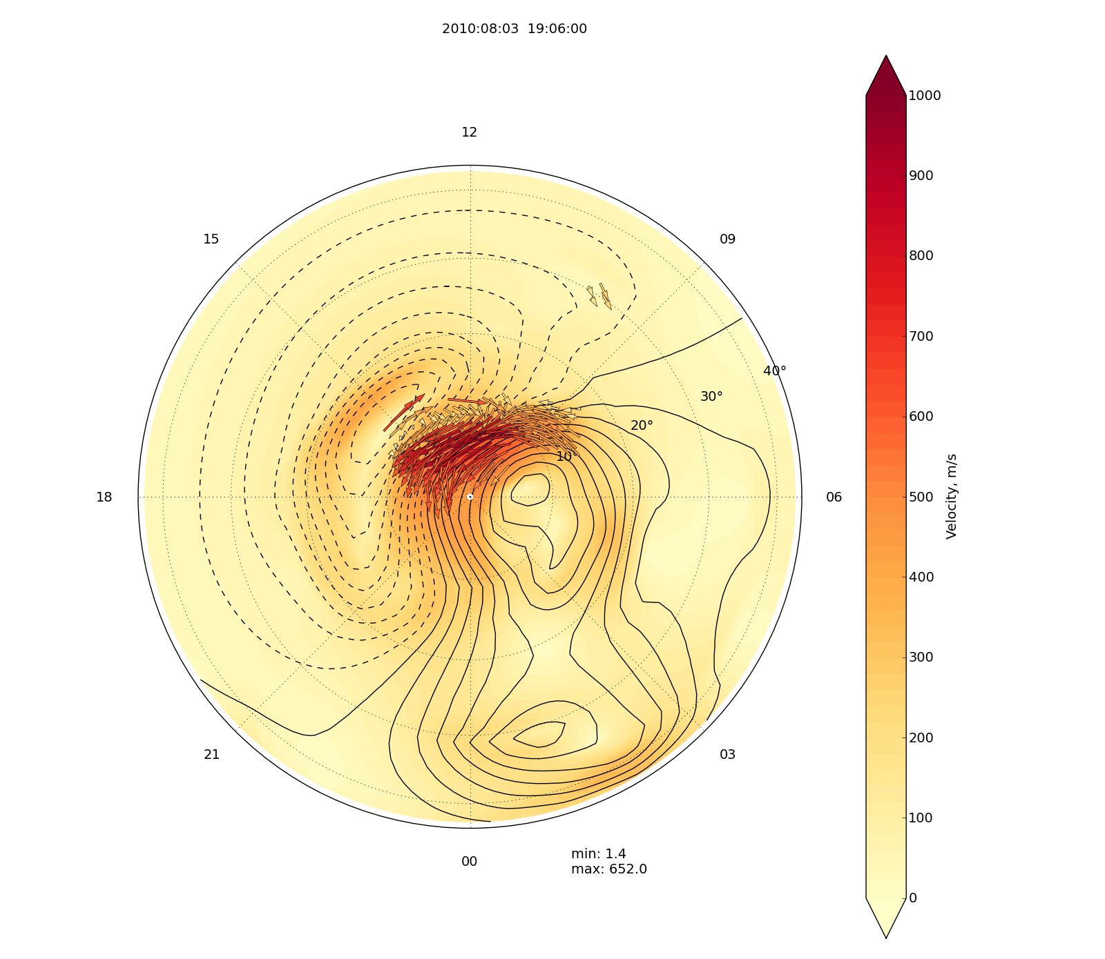
2010:08:03 19:06

Slide 39
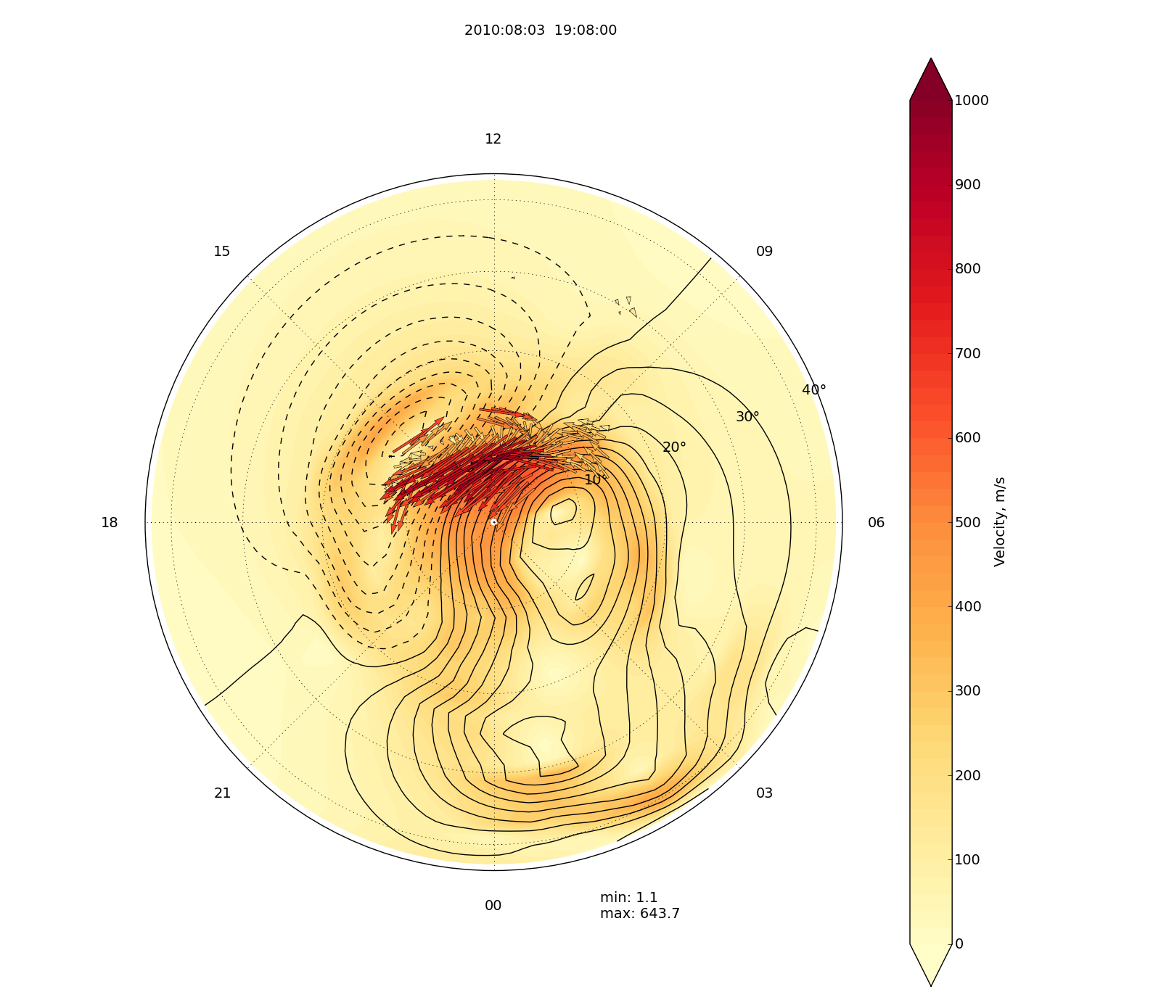
2010:08:03 19:08

Slide 40
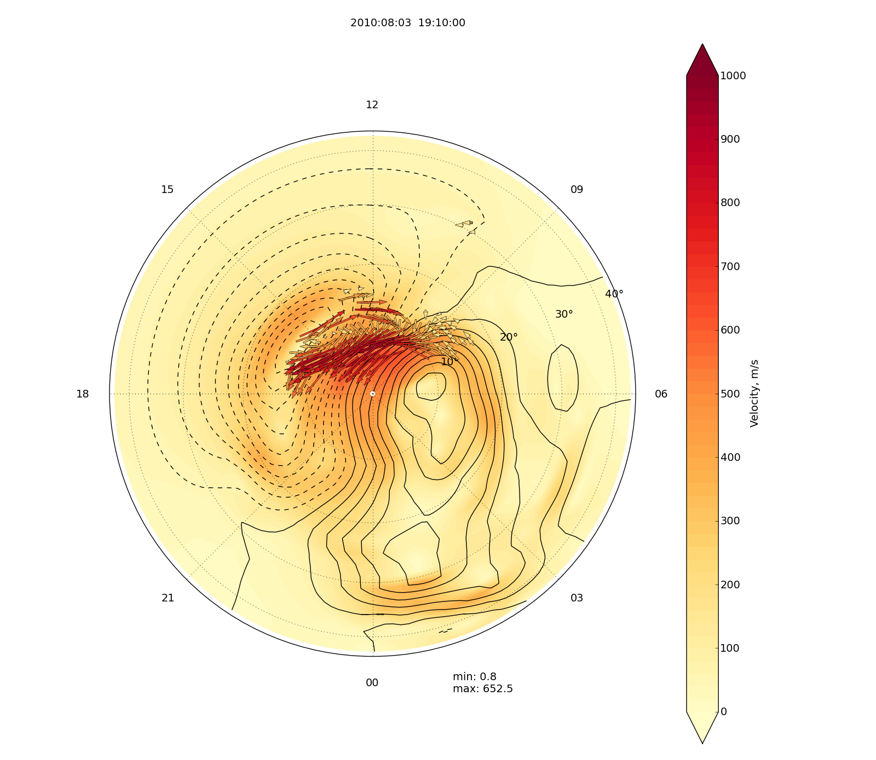
2010:08:03 19:10

Slide 41
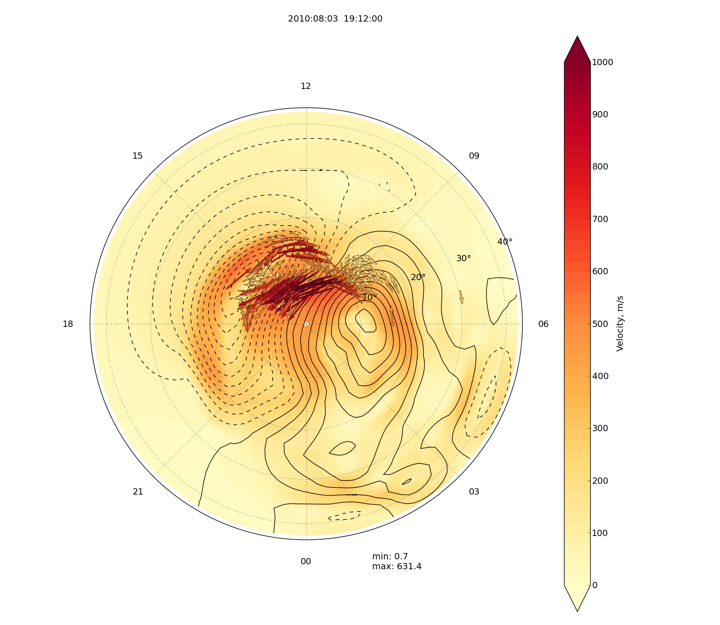
2010:08:03 19:12

Slide 42
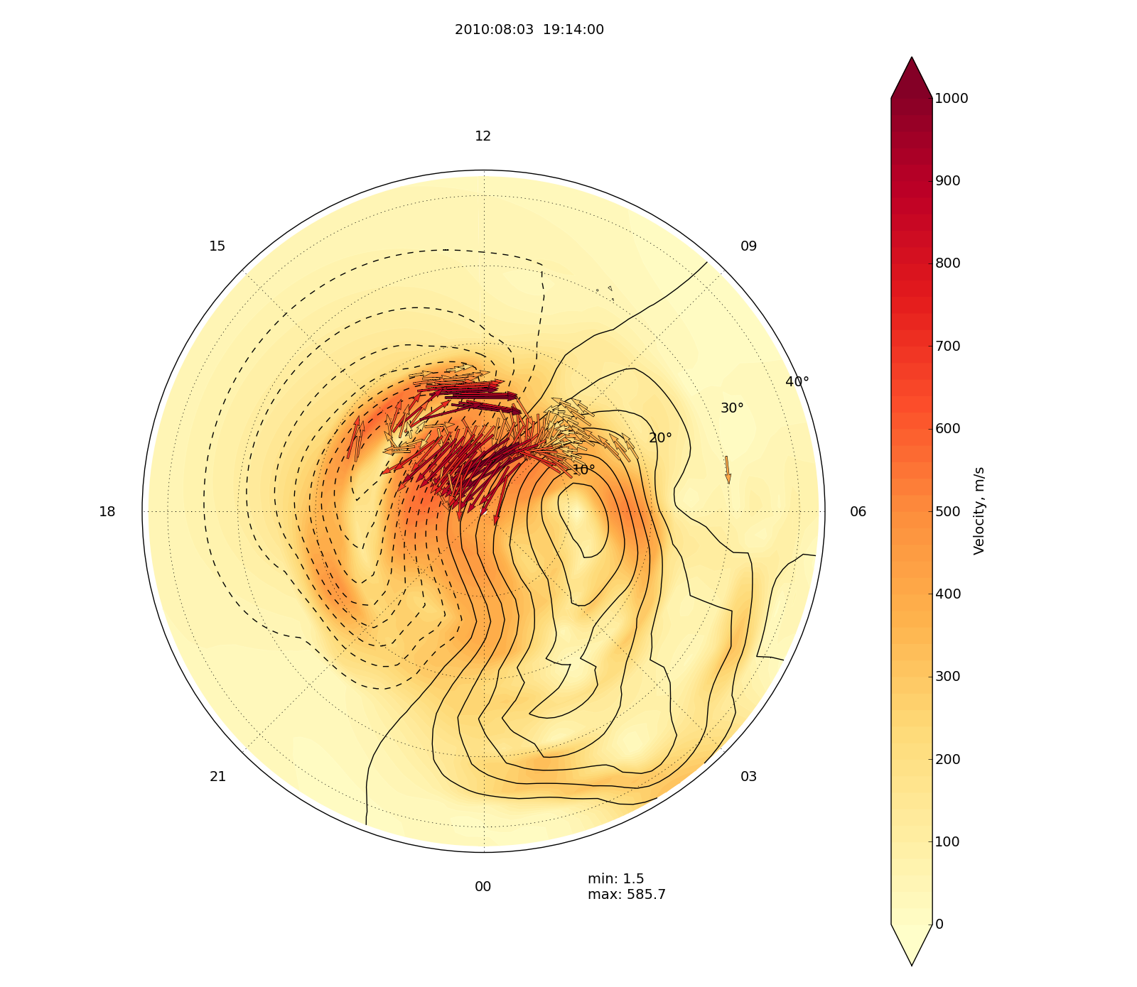
2010:08:03 19:14

Slide 43
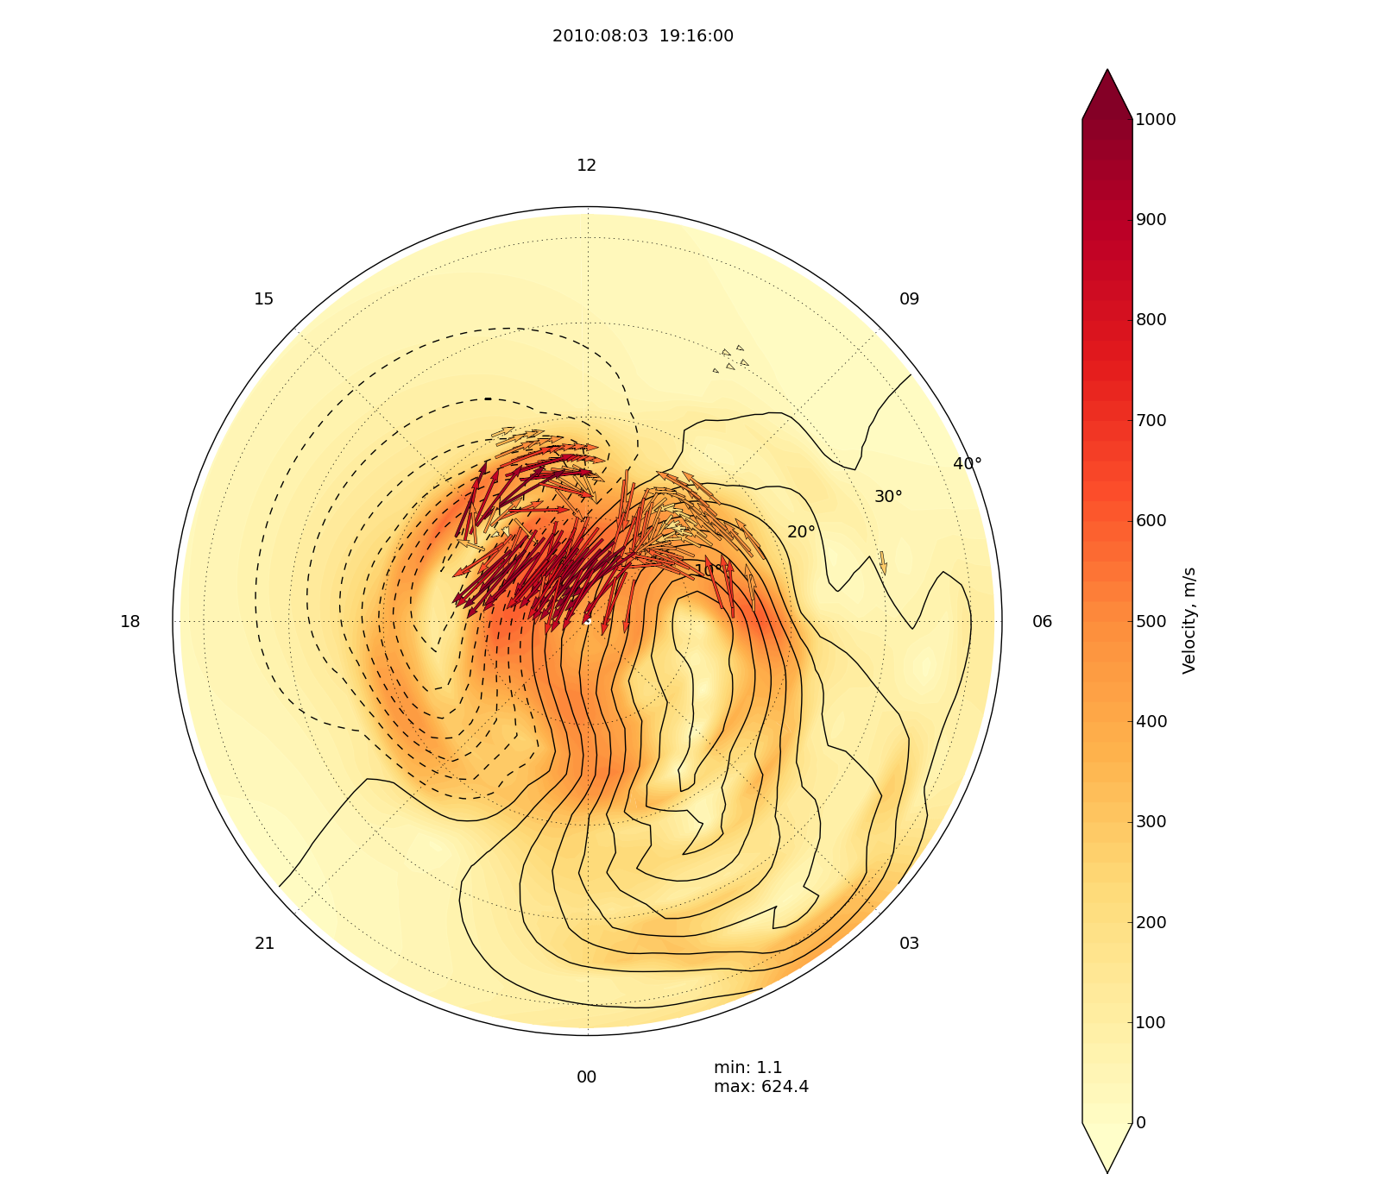
2010:08:03 19:16

Slide 44
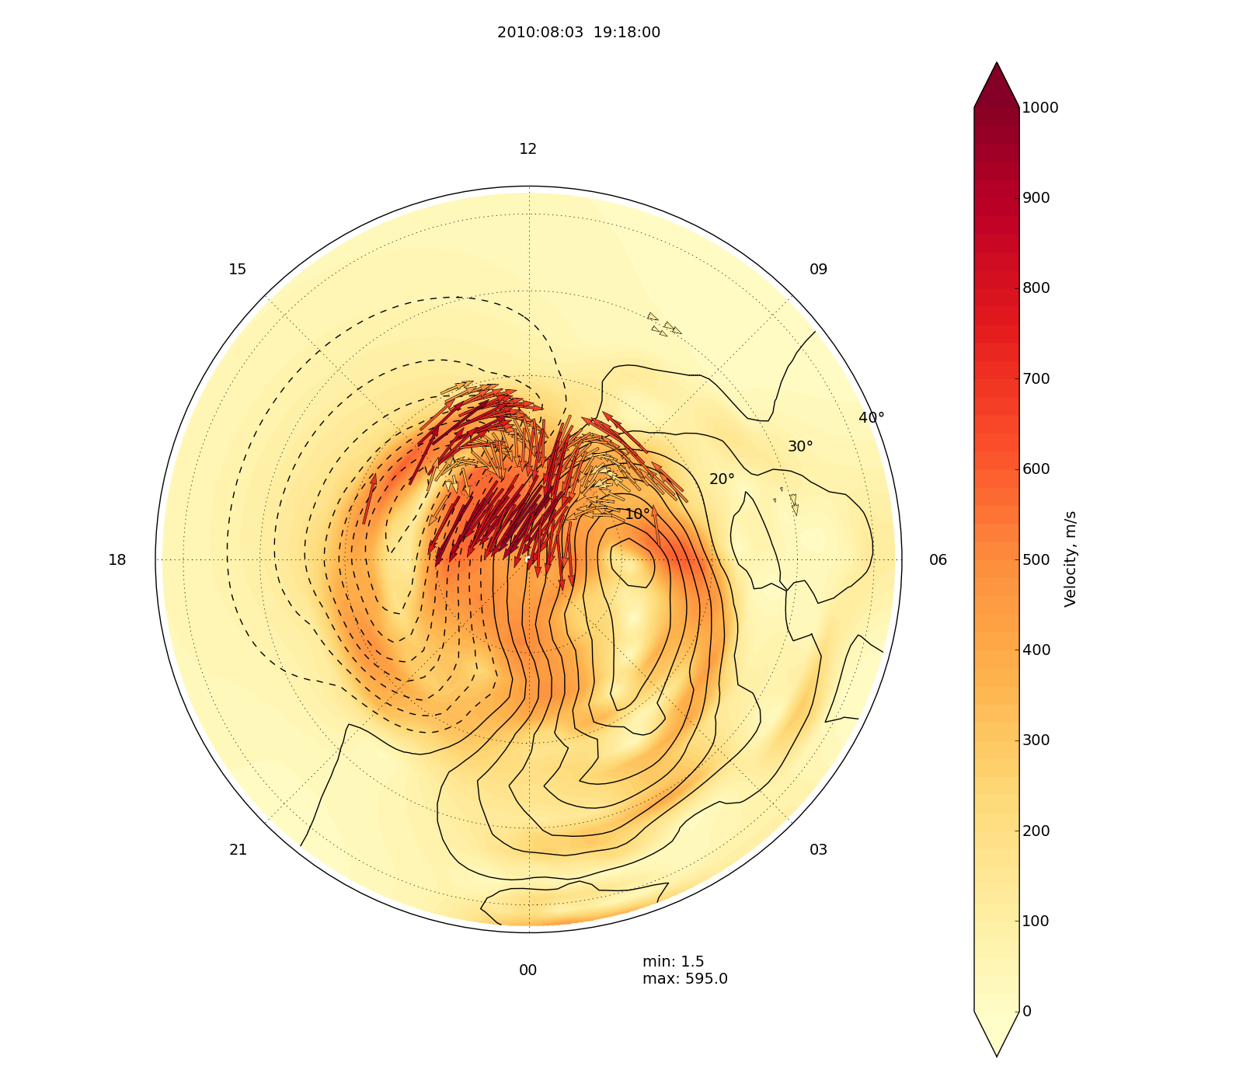
2010:08:03 19:18

Slide 45
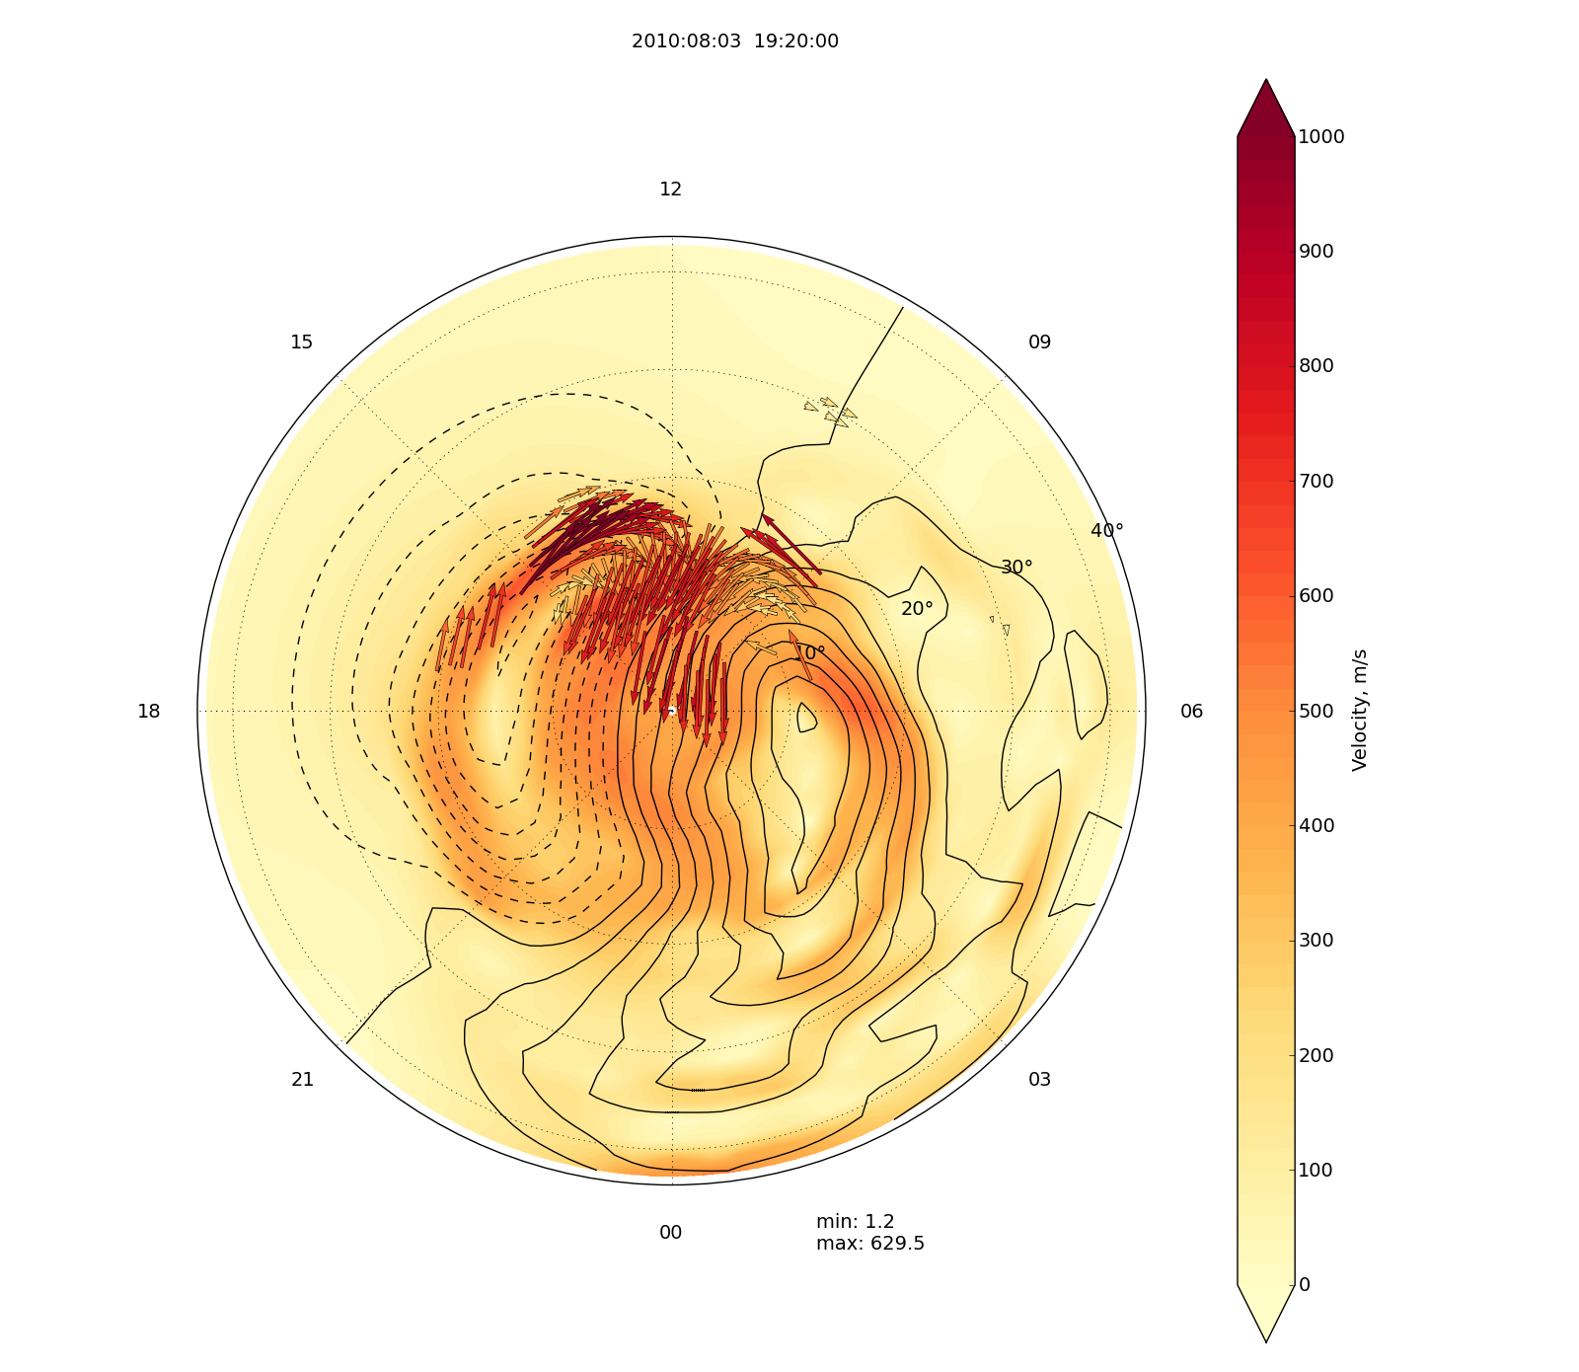
2010:08:03 19:20

Slide 46
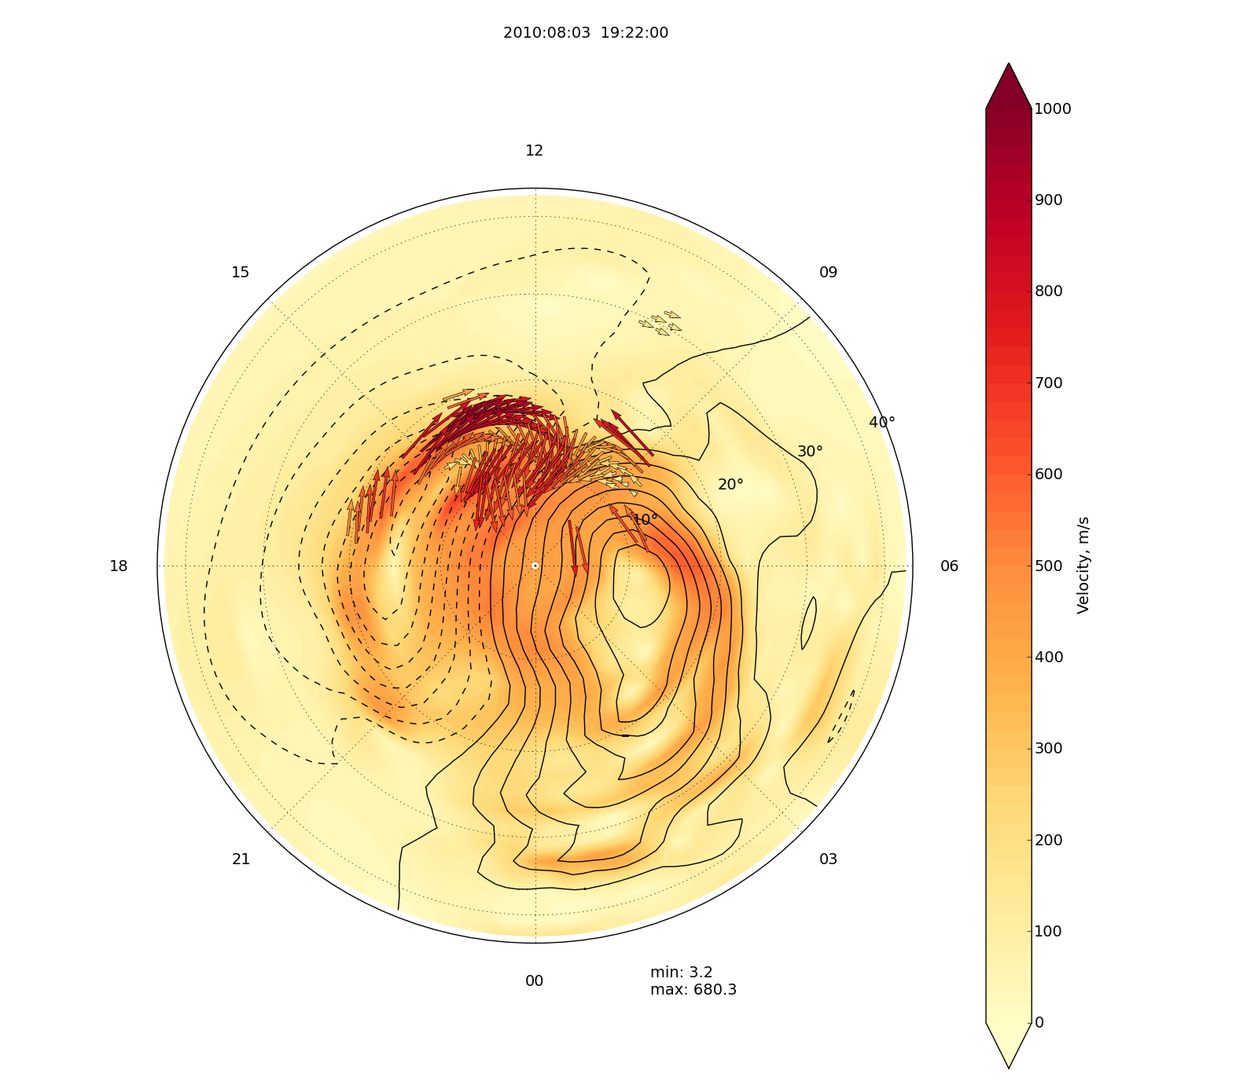
2010:08:03 19:22

Slide 47
Assessment
Locations of strong flows well reproduced in AMPERE-derived convection potentials
False positives and negatives are both low

Slide 48
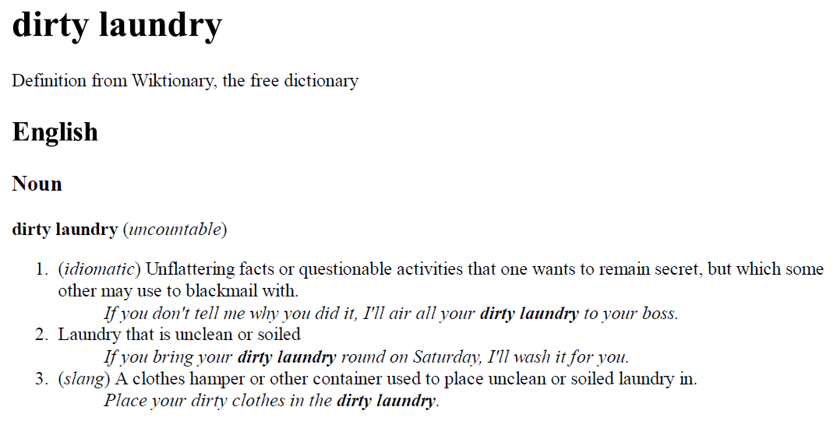

Slide 49
Step-like artifacts in δB
Advisory #1: Some step-like features are present which are on the list to investigate and mitigate

Slide 50
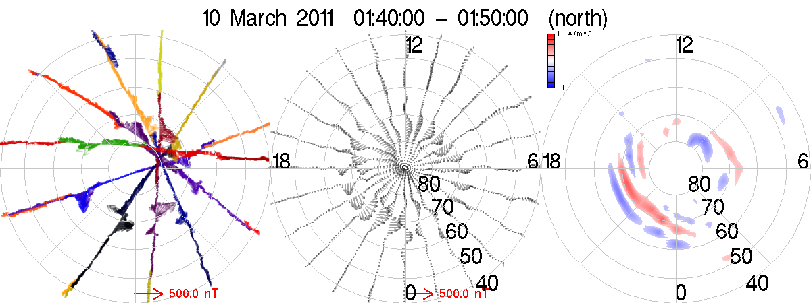
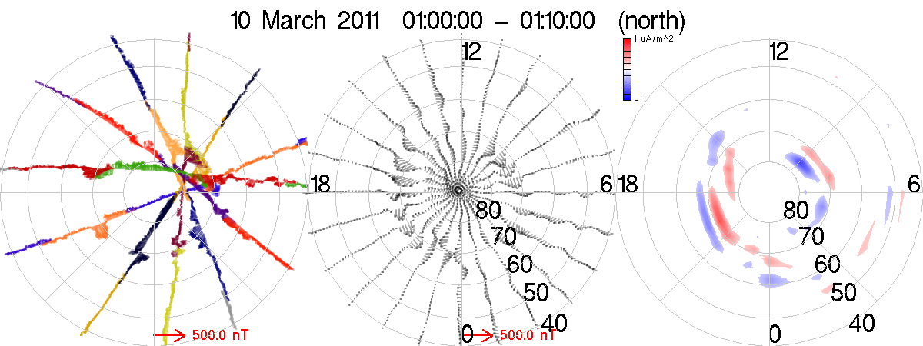
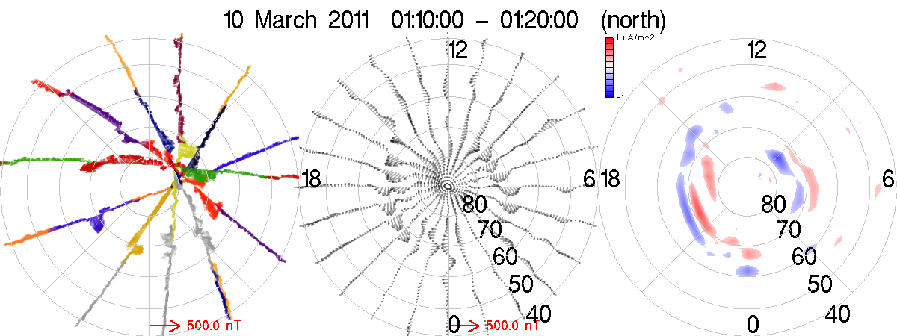

Slide 51
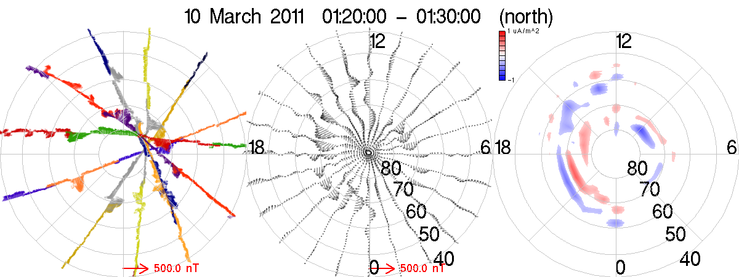
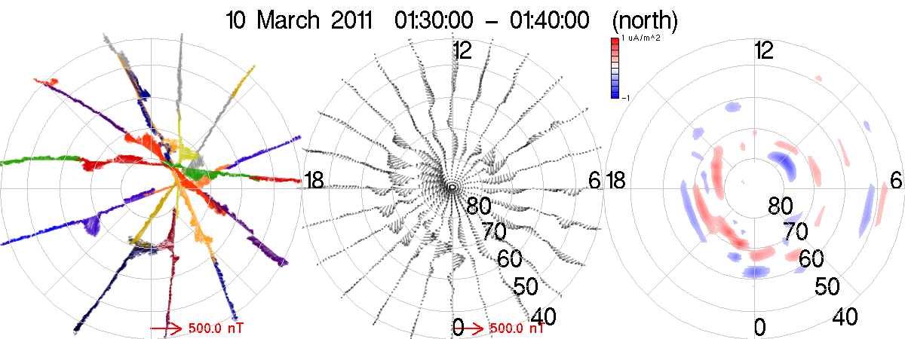

Slide 52
Limitation of fits: ringing
Advisory #2 (3-4 Aug 2010): Implementation of spherical harmonic fitting is subject to unphysical ‘ringing’ which is evident for strong currents. Regularizing the inversion is in the works.
Regularization should deal with this problem but remains to be tried

Slide 53
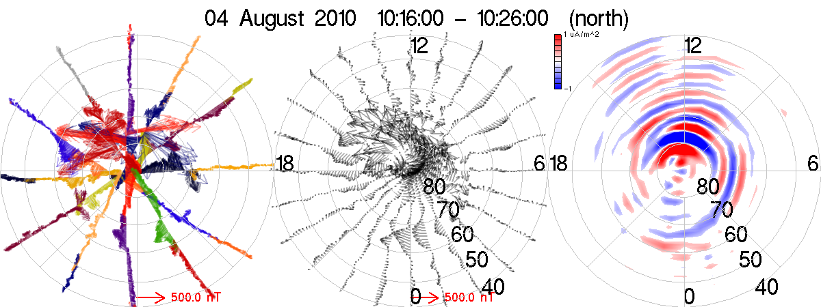

Slide 54
~10x disparity in lat/lon res.
Advisory #3: ‘sawtooth’ structure artifacts in currents.
Longitude resolution is ~30 deg, latitude resolution is at least 10x higher.
Origin for fit is centered near orbit crossing point
Conjecture: Fit cannot represent an oblique current sheet – it splits it into a series of ‘teeth’
Can regularization handle this? Include information from orientation of δB?

Slide 55
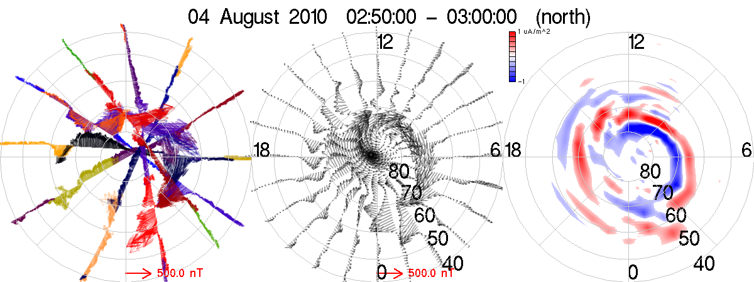

Slide 56
Data splicing
Gaps in composite tracks occur:
  Real data gaps from a given satellite (common before 12 June 2010)
  Satellites with ‘bad atittudes’ whose data are generally not usable
Data splicing:
  In each 10-min window replace ‘bad/missing’ data with interpolation of data from ahead and behind satellites
  Spliced data flagged and color plotted as grey
Fits often explode w/o splicing

Slide 57
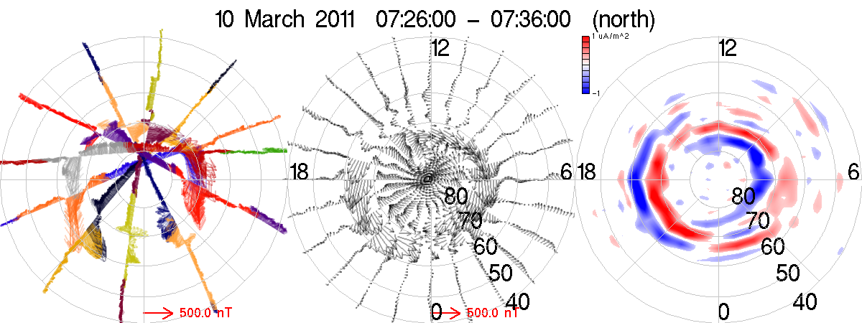

Slide 58
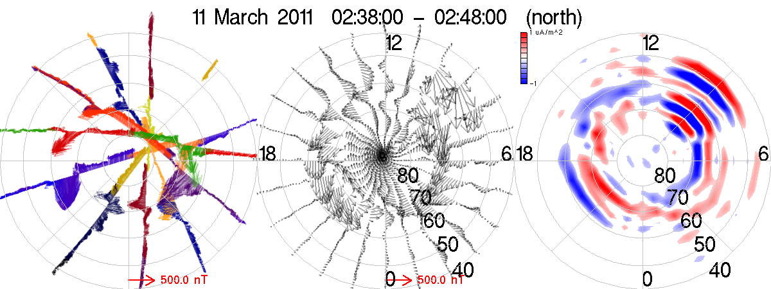

Slide 59
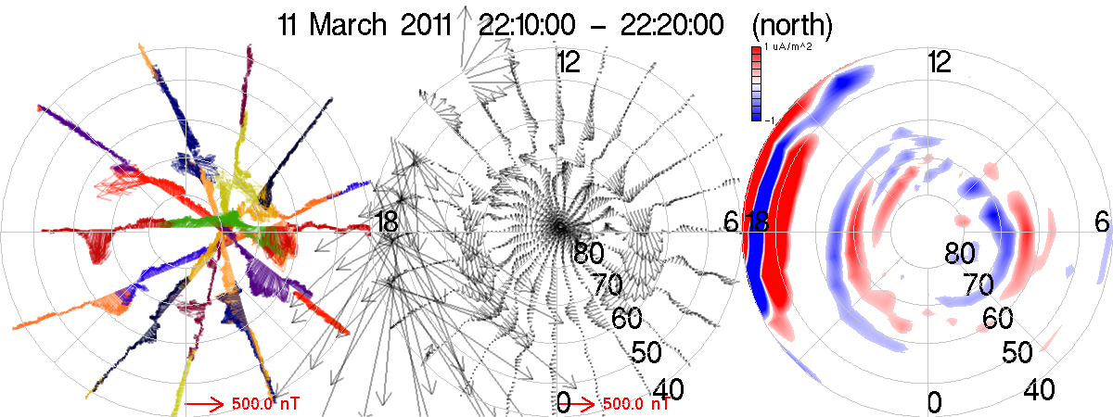

Slide 60
AMPERE-SuperDARN 10 Mar ‘11
Went to AMPERE high for this CME-driven storm
Quick check of what there is for comparison with SuperDARN

Slide 61
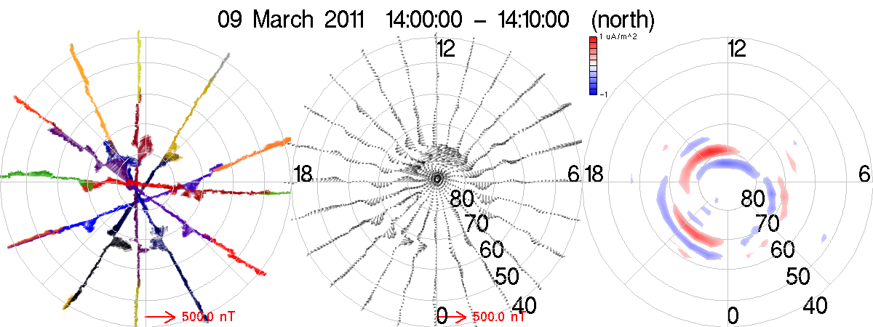
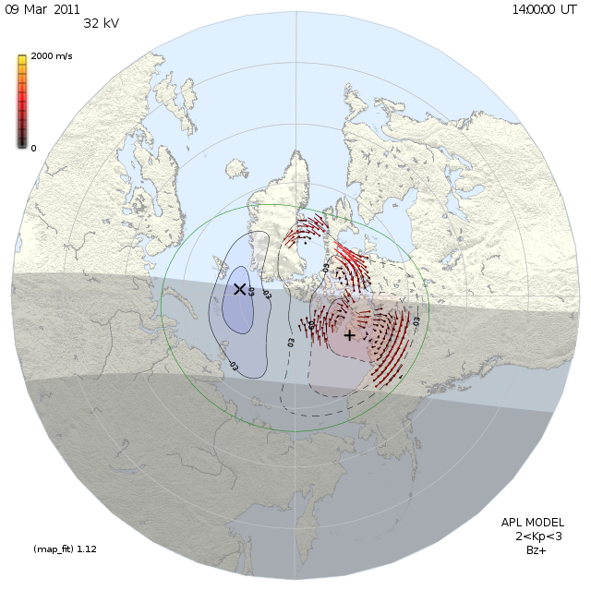
Huh…

Slide 62
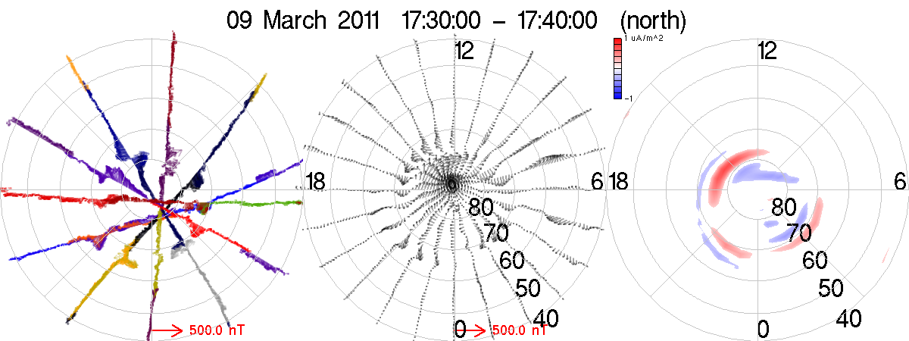
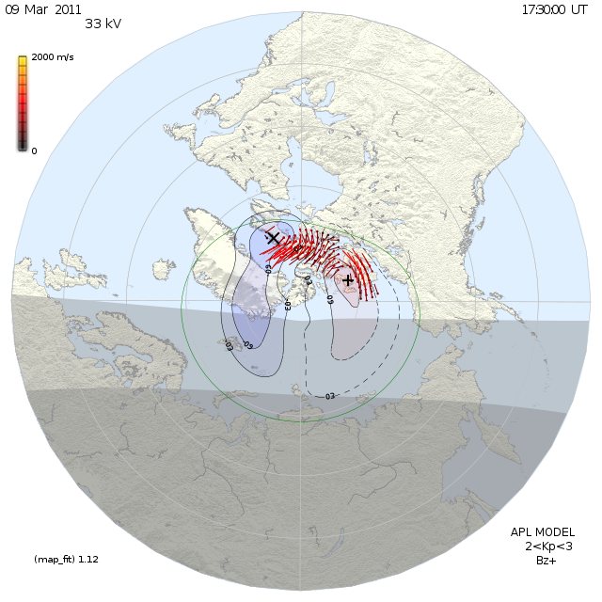
Okay…

Slide 63
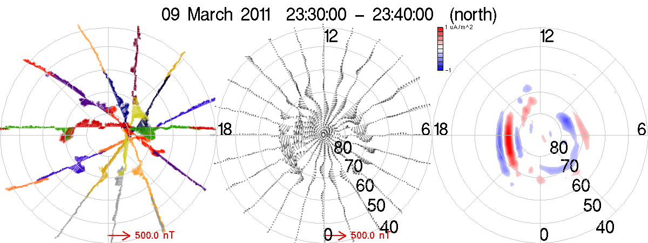
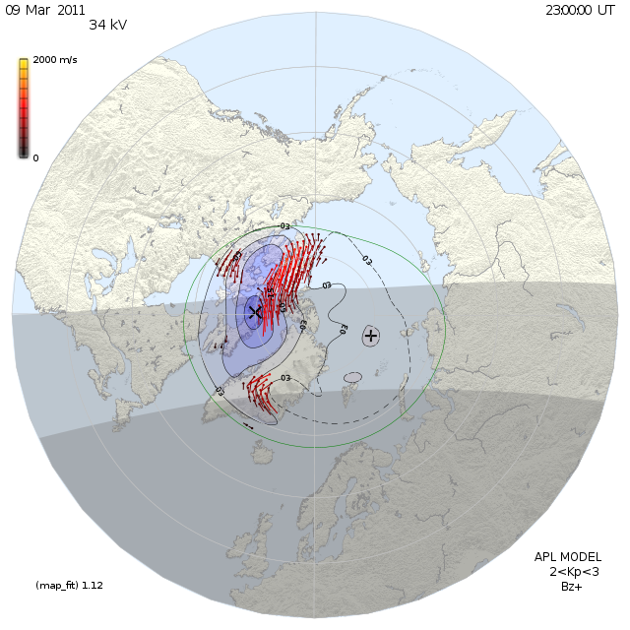
Ah, well…

Slide 64
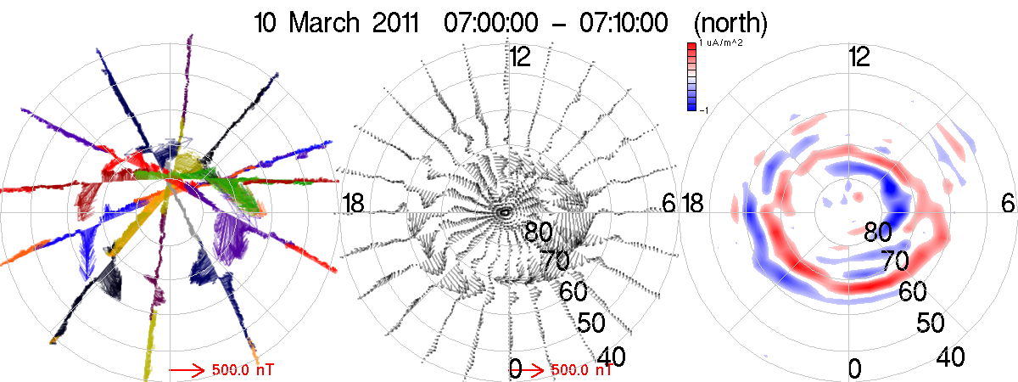

shucks…

Slide 65


darn…

Slide 66


hm…

Slide 67


super darn!

Slide 68

We may need to team up!
It’s worked before!

Slide 69
Draw on mutual strengths
Use AMPERE to provide a global context for dense regional observations from SuperDARN
3 Aug 2010 – Merkin (SD2010):
  1700 to 2300 @ 30 min intervals

Slide 70


Slide 71


Slide 72


Slide 73


Slide 74


Slide 75


Slide 76


Slide 77


Slide 78


Slide 79


Slide 80


Slide 81


Slide 82


Slide 83
Conclusions
AMPERE development is on schedule
First data products released: ampere.jhuapl.edu
Joint analyses between AMPERE and SuperDARN are just getting started
  Each resource has its own strengths and weaknesses
  Correspondence found so far is very encouraging
One possible approach: use AMPERE to help provide global context for regional observations
Curious, clever investigators working without ‘centralized’ guidance are the best way to make the discoveries hiding in the data!

